Slide 1
Greenplum Workshop
Introduction

Slide 2
Pivotal Greenplum Workshop Overview
What you will take home from this workshop?
An understanding of the Pivotal Greenplum database
What we assume you know already?
SQL and maybe a little bit PostgreSQL
What you will have in this workshop?
Some slideware, some discussion, some hands on labs
Where will you run the lab exercises?
A small cloud based Greenplum instance

Slide 3
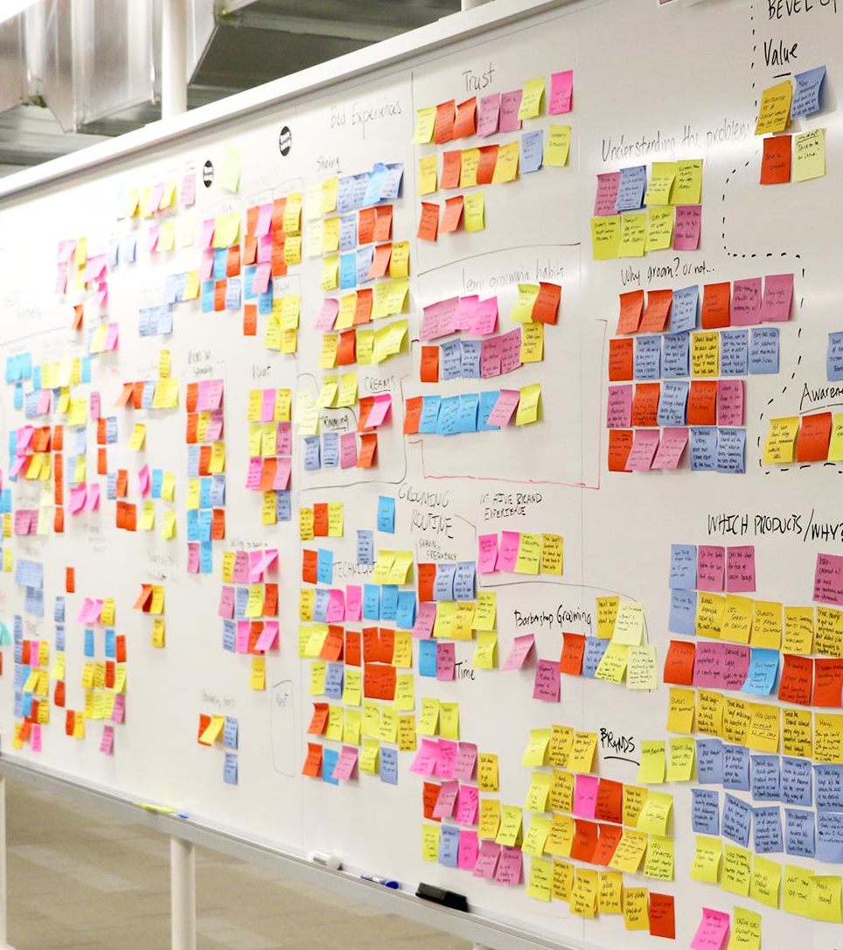
Agenda
Introduction to MPP and Greenplum
Differences Between PostgreSQL and Greenplum
Distribution -- a key to good performance in Greenplum
Parallel loading -- loading multiple Terabytes per hour
Loading from S3 and external connectivity
Polymorphic storage and external partitions
Partitioning vs. Distribution -- how they interact
Query response time exercises
Running Analytics in Greenplum: MADlib exercise
Analyzing Free Form Text with Solr and GPText
Running PL/Python and PL/R as Trusted Languages with PL/Container

Slide 4

Topics without exercises in this Workshop
Installation
Updates
Backup and recovery
Migration from other RDMS
Hadoop and other integration
Workload Management
Greenplum Command Center
Writing PXF extensions
PostGIS
Encryption
Security

Slide 5

But first, a little history
Notes:
When people first moved away from expensive mainframe computers, they did their data analytics in Symmetric MultiProcessors. They would start with a small box <CLICK> but would soon outgrow it and then need to move to a larger one <CLICK> , and when they outgrew it, move to a yet larger one. <CLICK> Costs became prohibitive and performance began to suffer. So, people in the data world became to do what people in the scientific computing world had done: scaling out rather than scaling up. <CLICK>

Slide 6
But first, a little history
Notes:
When people first moved away from expensive mainframe computers, they did their data analytics in Symmetric MultiProcessors. They would start with a small box <CLICK> but would soon outgrow it and then need to move to a larger one <CLICK> , and when they outgrew it, move to a yet larger one. <CLICK> Costs became prohibitive and performance began to suffer. So, people in the data world became to do what people in the scientific computing world had done: scaling out rather than scaling up. <CLICK>

Slide 7
But first, a little history
Notes:
When people first moved away from expensive mainframe computers, they did their data analytics in Symmetric MultiProcessors. They would start with a small box <CLICK> but would soon outgrow it and then need to move to a larger one <CLICK> , and when they outgrew it, move to a yet larger one. <CLICK> Costs became prohibitive and performance began to suffer. So, people in the data world came to do what people in the scientific computing world had done: scaling out rather than scaling up. <CLICK>

Slide 8
Massively Parallel Processing (MPP) Scaling out, not up.
Notes:
But in an MPP, scale out architecture, we increase computing power and storage by starting small <CLICK> In most MPP architectures today, the nodes are usually small Linux servers with enough CPU, RAM, and I/O power for the needs at hand. When we run out of any of these resources , we add another node or more . <CLICK> Since each node has its own memory, OS, CPU and storage with its own set of disks, this architecture is known as a Shared Nothing architecture.

Slide 9
Massively Parallel Processing (MPP) Scaling out, not up.
Notes:
But in an MPP, scale out architecture, we increase computing power and storage by starting small <CLICK> In most MPP architectures today, the nodes are usually small Linux servers with enough CPU, RAM, and I/O power for the needs at hand. When we run out of any of these resources , we add another node or more . <CLICK> Since each node has its own memory, OS, CPU and storage with its own set of disks, this architecture is known as a Shared Nothing architecture.

Slide 10
Massively Parallel Processing (MPP) Scaling out, not up.
Notes:
But in an MPP, scale out architecture, we increase computing power and storage by starting small <CLICK> In most MPP architectures today, the nodes are usually small Linux servers with enough CPU, RAM, and I/O power for the needs at hand. When we run out of any of these resources , we add another node or more . <CLICK> Since each node has its own memory, OS, CPU and storage with its own set of disks, this architecture is known as a Shared Nothing architecture.

Slide 11

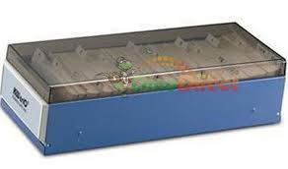
A brief analogy
Notes:
A colleague has a large collection of business cards. He exchanges business cards with everyone he meets. He has collected 10,000 business cards.
Being no fool, he keeps them sorted in alphabetical order: last name, first name. When he needs to look up someone’s contact info and he knows the name, it’s a no-brainer. He goes to roughly the write place in the alphabet and scans a few cards, taking a few seconds.
Occasionally he needs different information He’s visiting Acme Widget and want to find all his contacts who work for them. This requires going through all his cards. Now he can scan through cards at a pretty rapid rate, say 100/minute. For this current card stack, this takes 10,000/100=100 minutes. This is too long and he came to me for advice.

Slide 12


A brief analogy
Notes:
“Don’t you have a lot of interns working for you? Why not enlist the help of 10 of them, divide the cards equally among the 10, and have each intern scan the cards in parallel?” 10,000 cards/10 interns=1000 cards/intern. Assuming the interns can also scan cards at 100/minute, they can get the job done in 10 minutes, a 10X speedup over a single user. If we had used 50 interns, the job could be finished in 2 minutes, a 50X speedup. We get linear scalability from this strategy.
Our parallel solution has the advantage of faster lookups. And my friend can use a similar parallel strategy for loading news sets of cards he gets at the next Strata conference.
Notice that the process is the same whether we used 10 or 20 or 50 interns. Anytime he wants to ask a question of the business cards, my colleague does not need to know how many interns or who has which data. Once the cards are distributed, the parallelism is transparent to him.
What we have created is an analogue of an MPP (or massively parallel processing) database.
Disclaimer: No Interns were harmed in the processes mentioned above.

Slide 13



Greenplum = Massively Parallel Postgres for Analytics
SQL
Master Servers
Query planning and dispatch
Master
Host
Standby
Master
Interconnect
Interconnect
Node1
Node2
Node3
NodeN
Segment Servers
Query processing and data storage
Segment Host
Segment Host
Segment Host
Segment Host
…
External Sources & Pipelines
Parallel loading and streaming
Local
Storage
HDFS
Cloud
Object
Storage
GemFire
Spark
Other
RDBMSes
Spring
Cloud
Data Flow
ETL
Kafka

Slide 14

USERS
IT
Dev
Business
Analysts
Data
Scientists
ANALYTICAL
APPLICATIONS
SQL
Custom Apps
BI / Reporting
Machine Learning
AI
NATIVE INTERFACES
ANSI SQL
Other DB SQL
ML/Statistics/Graph
Programmatic
Text
GeoSpatial
JDBC, ODBC
Teradata SQL
Apache MADlib
Python. R,
Java, Perl, C
Apache Solr
PostGIS
NEXT
GENERATION
DATA
PLATFORM
PIVOTAL
GREENPLUM
PLATFORM
Massively
Parallel
(MPP)
Petabyte
Scale
Loading
Query
Optimizer
(GPORCA)
Workload
Manager
Polymorphic
Storage
Command Center
SQL Compatibility
(Hyper-Q)
PostgreSQL
Kernel
MULTI-
STRUCTURED DATA
Structured Data
JSON, Apache AVRO, Apache Parquet and XML
SOURCES &
PIPELINES
Local
Storage
HDFS
Cloud
Object
Storage
GemFire
Spark
Other
RDBMSes
Spring
Cloud
Data Flow
ETL
Kafka
FLEXIBLE
DEPLOYMENT
On-Premises
Public
Clouds
Private
Clouds
Fully
Managed
Clouds

Slide 15
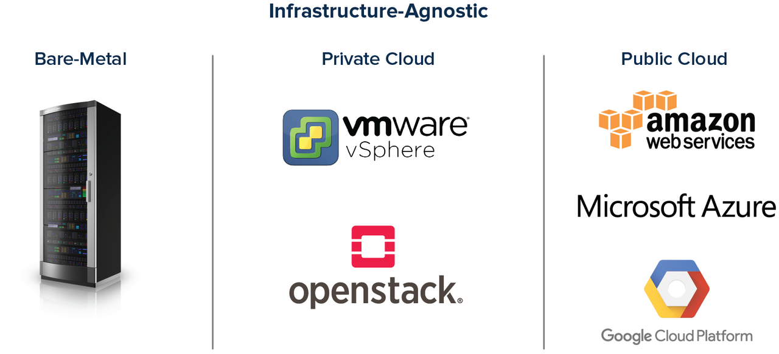
Run your analytics anywhere you need it
Infrastructure Agnostic: A portable, 100% software solution
Same platform, no switching/migration cost
Notes:
Pivotal Greenplum can run in all platforms. It's a pure software solution. All optimizations are based on the software and not on any hardware optimization.
We can run on premises, private or public cloud and using also DellEMC appliances. This is the same software that you are deploying whatever the target platform
Pivotal Greenplum is also available on public cloud marketplaces as the one from Amazon or Microsoft. You can instantiate a Greenplum cluster in few minutes.

Slide 16
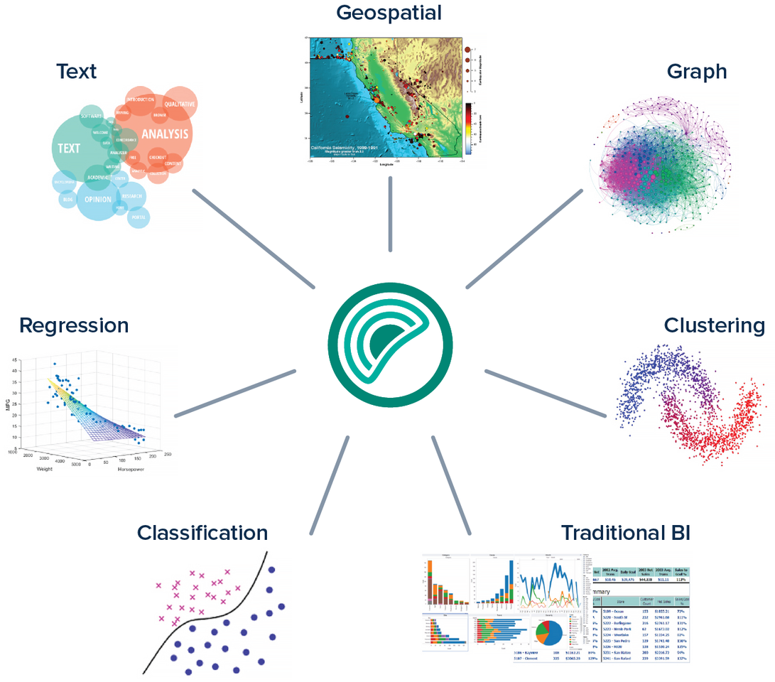
Greenplum Integrated Analytics
Traditional and Advanced In-Database Analytics
Notes:
Greenplum is the perfect platform to modernize existing EDWs and eliminate the need for analytical silos created by new tools and libraries
Pivotal Greenplum is able to migrate and support traditional DW workloads (BI/reporting) in the same platform where it runs Machine learning and Advanced analytics in-database using a massively parallel architecture

Slide 17

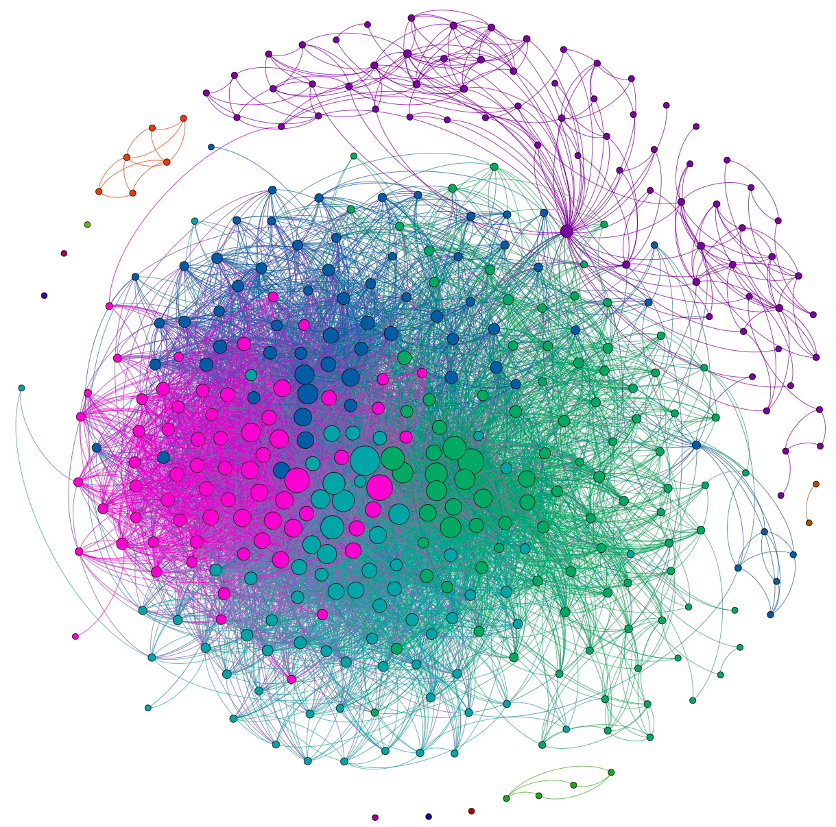
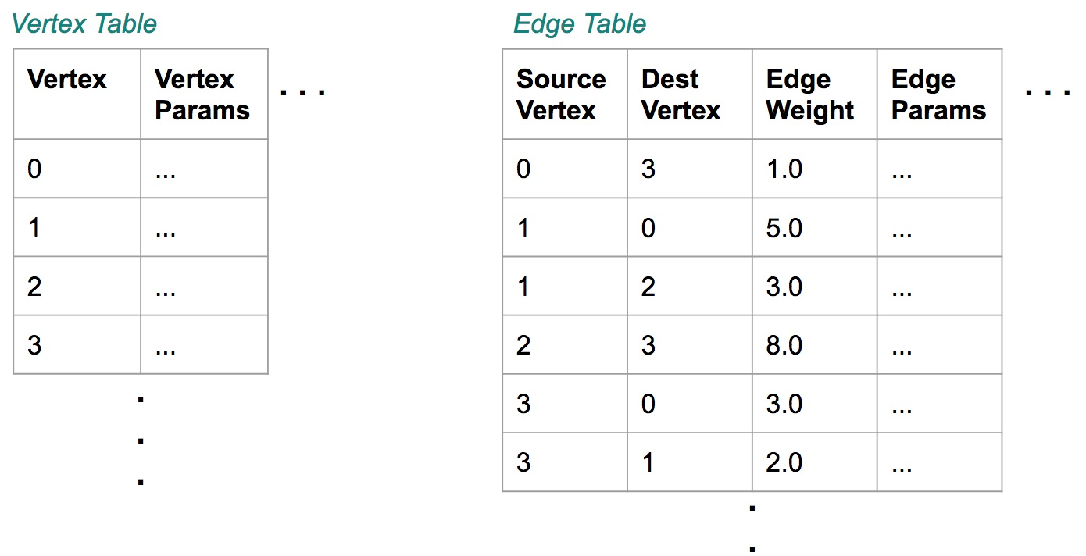
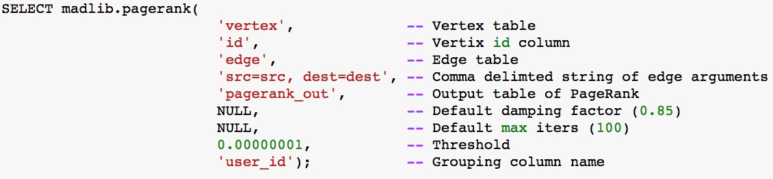
Greenplum Analytics: Graph
Designed for very large graphs (billions of vertices/edges)
No need to move data and transform for external graph engine
Support for most popular graph algorithms
Familiar SQL interface
Notes:
Algorithms:
All Pairs Shortest Path (APSP)
Breadth-First Search
Average Path Length
Closeness Centrality
Graph Diameter
In-Out Degree
PageRank
Single Source Shortest Path (SSSP)
Weakly Connected Components

Slide 18

Greenplum Analytics: Text
Use Cases
Communications compliance and monitoring
Customer Sentiment analysis
Document Search and Query
Social Media Processing, etc.
Greenplum Technology: GPText
Leverages Apache Solr and Greenplum
Python and Java integration for Natural Language Processing
Apache Madlib integration for machine learning on text data

Slide 19

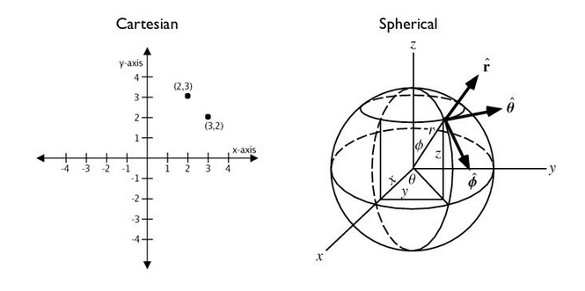
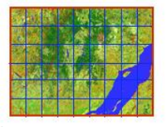
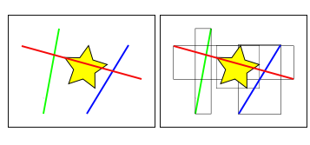
Greenplum Analytics: GeoSpatial
Points, Lines, Polygons, Perimeter, Area
Intersection, Contains, Distance, Long/Latitude
Round earth calculations
Spatial Indexes & Bounding Boxes
Raster Support
Notes:
Let’s talk about diversity in term of datatype and let’s start with Geospatial support
Greenplum is providing Geospatial support through postGIS implementation.
In few words it adds spatial functions such as distance, area, ability to manipulate polygon and special data types and index to speed the processing.
Postgis implementation give opportunity to manage all geolocation uses cases inside the database.

Slide 20












Greenplum Analytics: R and Python Libraries
Notes:
The list on this slide is partial. All the supported libraries are below.
All supported libraries will fully leverage the Greenplum MPP architecture:
Python libraries to be supported in Greenplum v5:
Tensorflow, NumPy, SciPy, scikit-learn, Pandas, NLTK, Pattern-en, Statsmodels (python lib), gensim (python lib), pyldavis, lifelines, spaCy, XGBoost, BeautifulSoup, lxml, Keras, and PyMC3 (Tensorflow and Keras require RHEL 7 as host OS).
R libraries to be supported in Greenplum v5:
BH, DBI, MASS, MCMCpack, Matrix, R2jags, R6, RColorBrewer, ROCR, RPostgreSQL, Rcpp, RcppEigen, RobustRankAggreg, SparseM, abind, adabag, arm, assertthat, bitops, caTools, car, caret, coda, colorspace, compHclust, curl, data.table, dichromat, digest, dplyr, e1071, flashClust, forecast, foreign, gdata, ggplot2, glmnet, gplots, gtable, gtools, hms, hybridHclust, igraph, labeling, lattice, lazyeval, lme4, lmtest, magrittr, minqa, MTS, munsell, neuralnet, nloptr, nnet, pbkrtest, plyr, quantreg, randomForest, readr, reshape2, rjags, rpart, sandwich, scales, stringi, stringr, survival, tibble, tseries, zoo.

Slide 21
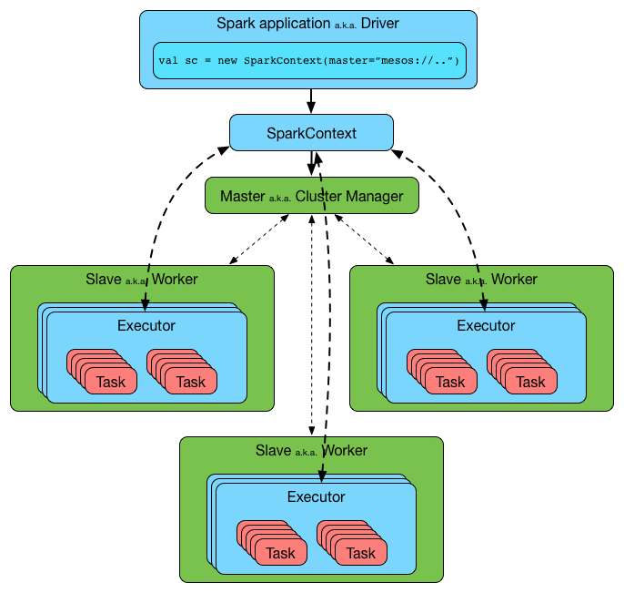


Greenplum Analytics: Spark
Spark - Greenplum connector
In-memory processing
Provide Data Access to Greenplum Data
Leverage SPARK Skill Set of Data Scientists
Leverage off-cluster compute resources to do computations
Push result sets back into Greenplum for storage

Slide 22







Greenplum Analytics: Language Agnostic
Interfaces
User Defined Types
User Defined Functions
User Defined Aggregates
Foundational work for containerized Python and R compute environments
+
+

Slide 23
R/Python Containerization on Greenplum: PL/Container
+
+
Deploy Custom R & Python Developer Environment(s) To Cluster
Execute Functions in Isolated Secure Containers
Deploy code and functions as non super-user
Package any custom Python and R modules in the deployment
Pre-configured for Data Science or customized images by users
Multiple developer environments on same cluster

Slide 24
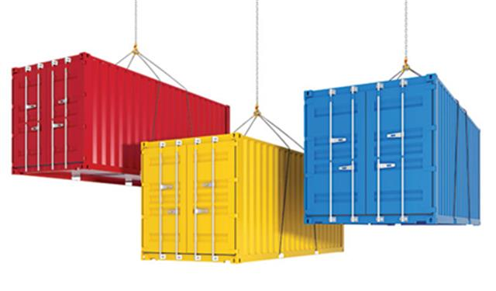
SQL Containerization: Greenplum Resource Groups
Resource isolation for multi-tenancy and mixed analytical SQL workloads
Enhances stability and manageability
Leverages Linux Cgroups
SQL
Notes:
CAPABILITIES
Leverages Linux Cgroups for implementation
Specify CPU Max Per Group
Burst Above Max Limit if available
Specify Max Memory Per Group And Memory Per Query
Specify Max Concurrency Per Group
Transaction scope not Statement scope

Slide 25

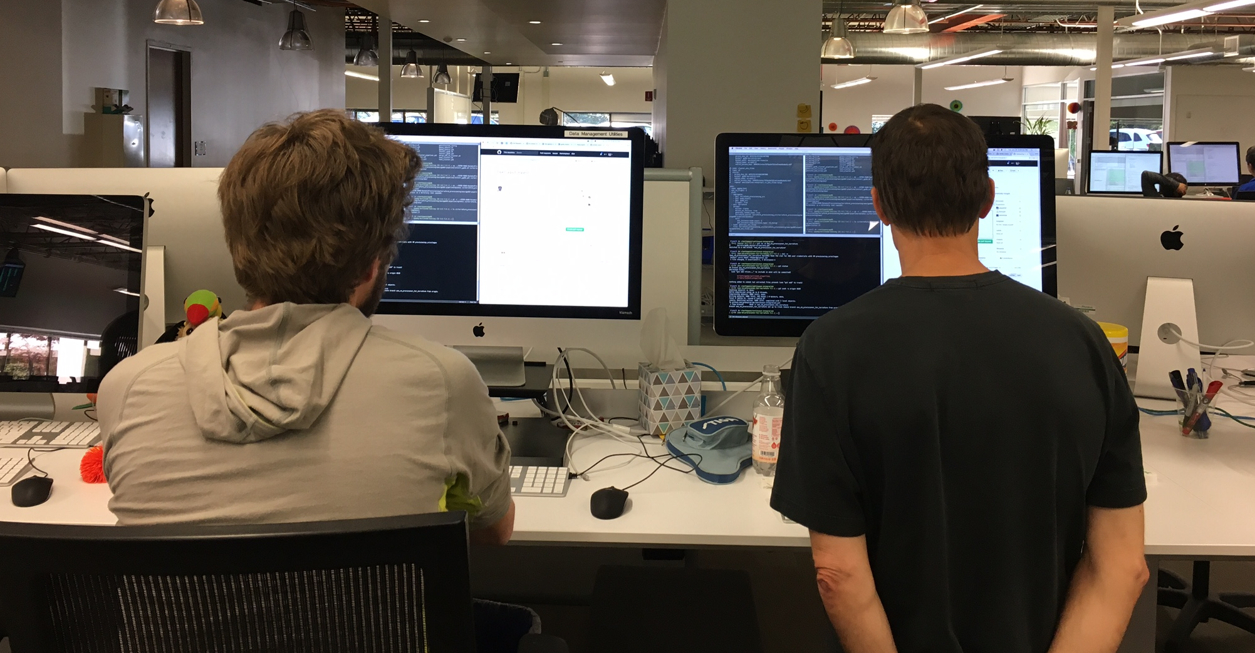
Greenplum Open Source Agility = Analytical Innovation
100% based on PostgreSQL innovation, the most advanced analytical database for PostgreSQL users
Agile development
A new Pivotal Greenplum release every month

Slide 26

Download at Greenplum.org

Slide 27
Pivotal Greenplum by Pivotal - Support Offering
Binaries and Installers
Production Ready Releases
24x7 Premium Support
Pivotal is the top Greenplum sponsor and steward worldwide
12 years of engineering experience with Greenplum
Drives the Roadmap of Pivotal Greenplum
Largest contributor and committer to open source Greenplum Database

Slide 28
Pivotal Greenplum Modules - Proprietary Pivotal Modules
Greeplum Command Center: Graphical DBA Console for Centralized Management
GPText: Apache Solr Integration for Indexing and Search of Text Data
Gemfire Connector: Import/Export for Low Latency, High Concurrency Access
Spark Connector: Consume Greenplum data in Spark Analytics Jobs
Informatica Connector: ETL with industry leading solution integration
ODBC & JDBC Drivers: Industry standard data provided by Progress Software
QuickLZ Compression: High speed proprietary data compaction algorithm

Slide 29
Other Good Stuff
Greenplum Database documentation is approximately 1500 pages.
All Pivotal documentation is freely available at https://docs.pivotal.io/
The best practices guide begins near page 630.
The Greenplum YouTube channel: https://www.youtube.com/channel/UCIC2TGO-4xNSAJFCJXlJNwA/
Pivotal's Jon Roberts runs a website called http://www.pivotalguru.com/ . It has lots of useful information and Jon also answers questions.
An invaluable resource with lots of good information is the Greenplum OSS website: https://greenplum.org/ You can sign up there to see the users and developers notes.

Slide 30

Transforming How The World Builds Software

